Slide 1
Storage Systems
Notes:
Relative to book, I included more material on the physics of the disk head
Mentioned that disk and flash device has a CPU in it – it needs it for the complex reasoning it needs to make; e.g., disk head scheduling is now done by the disk device itself, as is remapping. Disks in very olden times very smart – because the CPU was insanely expensive. When CPU’s were moderately expensive, then I/O devices became dumb – so that you could build a cheaper overall system, the file system had to do more work. Now, the CPU is very cheap, so can include more intelligence on the device.
Or even, have a network appliance that appears like a disk, but is actually a CPU, a set of disks, and a bunch of clever algorithms.
Worth including material on error correcting codes here, I think
And we should update to a newer disk example
Also, the algebra for the 80% power point needed a bit more explanation (why multiply on the left hand side)

Slide 2
Main Points
File systems
Useful abstractions on top of physical devices
Storage hardware characteristics
Disks and flash memory
File system usage patterns

Slide 3
File Systems
Abstraction on top of persistent storage
Magnetic disk
Flash memory (e.g., USB thumb drive)
Devices provide
Storage that (usually) survives across machine crashes
Block level (random) access
Large capacity at low cost
Relatively slow performance
Magnetic disk read takes 10-20M processor instructions

Slide 4
File System as Illusionist: Hide Limitations of Physical Storage
Persistence of data stored in file system:
Even if crash happens during an update
Even if disk block becomes corrupted
Even if flash memory wears out
Naming:
Named data instead of disk block numbers
Directories instead of flat storage
Byte addressable data even though devices are block-oriented
Performance:
Cached data
Data placement and data structure organization
Controlled access to shared data

Slide 5
File System Abstraction
File system
Persistent, named data
Hierarchical organization (directories, subdirectories)
Access control on data
File: named collection of data
Linear sequence of bytes (or a set of sequences)
Read/write or memory mapped
Crash and storage error tolerance
Operating system crashes (and disk errors) leave file system in a valid state
Performance
Achieve close to the hardware limit in the average case

Slide 6
Storage Devices
Magnetic disks
Storage that rarely becomes corrupted
Large capacity at low cost
Block level random access
Slow performance for random access
Better performance for streaming access
Flash memory
Storage that rarely becomes corrupted
Capacity at intermediate cost (50x disk)
Block level random access
Good performance for reads; worse for random writes

Slide 7
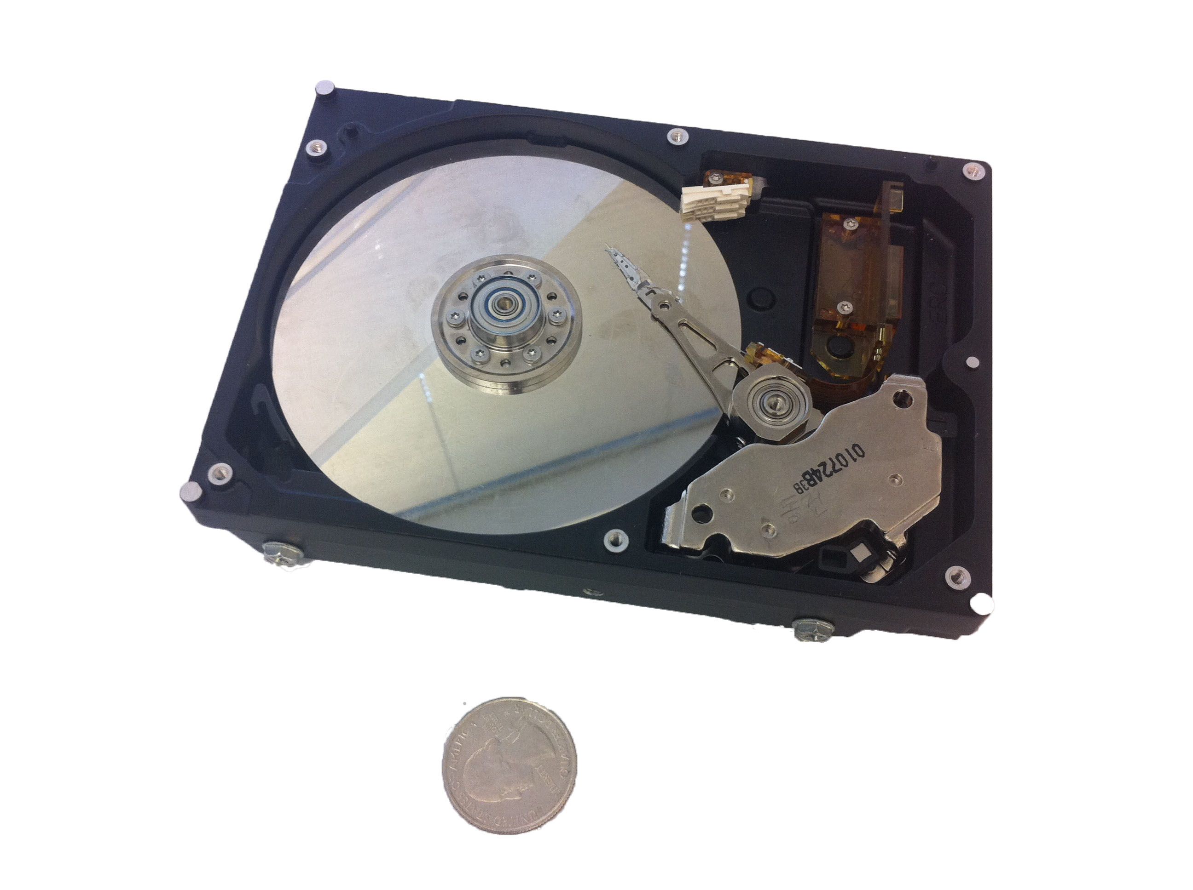
Magnetic Disk
Notes:
Mentioned that disk and flash device has a CPU in it – it needs it for the complex reasoning it needs to make; e.g., disk head scheduling is now done by the disk device itself, as is remapping. Disks in very olden times very smart – because the CPU was insanely expensive. When CPU’s were moderately expensive, then I/O devices became dumb – so that you could build a cheaper overall system, the file system had to do more work. Now, the CPU is very cheap, so can include more intelligence on the device.

Slide 8
Notes:
Head and track are not to scale – head is actually much much bigger than a track.
Track ~ 1 micron wide
Wavelength of light is ~ 0.5 micron
Resolution of human eye: 50 microns
Outer edge of disk is travelling at 30 mph, with the head riding on top of the disk surface with a cushion of a few atoms

Slide 9
Disk Tracks
~ 1 micron wide
Wavelength of light is ~ 0.5 micron
Resolution of human eye: 50 microns
100K tracks on a typical 2.5” disk
Separated by unused guard regions
Reduces likelihood neighboring tracks are corrupted during writes (still a small non-zero chance)
Track length varies across disk
Outside: More sectors per track, higher bandwidth
Disk is organized into regions of tracks with same # of sectors/track
Only outer half of radius is used
Most of the disk area in the outer regions of the disk

Slide 10
Sectors
Sectors contain sophisticated error correcting codes
Disk head magnet has a field wider than track
Hide corruptions due to neighboring track writes
Sector sparing
Remap bad sectors transparently to spare sectors on the same surface
Slip sparing
Remap all sectors (when there is a bad sector) to preserve sequential behavior
Track skewing
Sector numbers offset from one track to the next, to allow for disk head movement for sequential ops
Notes:
Error correcting code: ex: parity. But you can get more sophisticated.

Slide 11
Disk Performance
Disk Latency =
Seek Time + Rotation Time + Transfer Time
Seek Time: time to move disk arm over track (1-20ms)
Fine-grained position adjustment necessary for head to “settle”
Head switch time ~ track switch time (on modern disks)
Rotation Time: time to wait for disk to rotate under disk head
Disk rotation: 4 – 15ms (depending on price of disk)
On average, only need to wait half a rotation
Transfer Time: time to transfer data onto/off of disk
Disk head transfer rate: 50-100MB/s (5-10 usec/sector)
Host transfer rate dependent on I/O connector (USB, SATA, …)

Slide 12
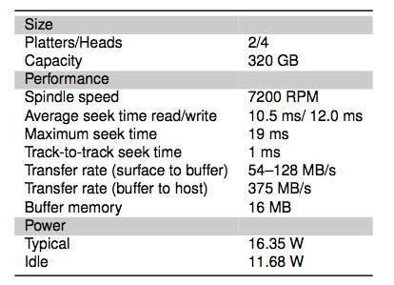
Toshiba Disk (2008)

Slide 13
Question
How long to complete 500 random disk reads, in FIFO order?

Slide 14
Question
How long to complete 500 random disk reads, in FIFO order?
Seek: average 10.5 msec
Rotation: average 4.15 msec
Transfer: 5-10 usec
500 * (10.5 + 4.15 + 0.01)/1000 = 7.3 seconds

Slide 15
Question
How long to complete 500 sequential disk reads?

Slide 16
Question
How long to complete 500 sequential disk reads?
Seek Time: 10.5 ms (to reach first sector)
Rotation Time: 4.15 ms (to reach first sector)
Transfer Time: (outer track)
500 sectors * 512 bytes / 128MB/sec = 2ms
Total: 10.5 + 4.15 + 2 = 16.7 ms
Might need an extra head or track switch (+1ms)
Track buffer may allow some sectors to be read off disk out of order (-2ms)

Slide 17
Question
How large a transfer is needed to achieve 80% of the max disk transfer rate?

Slide 18
Question
How large a transfer is needed to achieve 80% of the max disk transfer rate?
Assume x rotations are needed, then solve for x:
0.8 (10.5 ms + (1ms + 8.5ms) x) = 8.5ms x
Total: x = 9.1 rotations, 9.8MB

Slide 19
Disk Scheduling
FIFO
Schedule disk operations in order they arrive
Downsides?

Slide 20
Disk Scheduling
Shortest seek time first
Not optimal!
Suppose cluster of requests at far end of disk
Downsides?

Slide 21
Disk Scheduling
SCAN: move disk arm in one direction, until all requests satisfied, then reverse direction
Also called “elevator scheduling”

Slide 22
Disk Scheduling
CSCAN: move disk arm in one direction, until all requests satisfied, then start again from farthest request

Slide 23
Disk Scheduling
R-CSCAN: CSCAN but take into account that short track switch is < rotational delay

Slide 24
Question
How long to complete 500 random disk reads, in any order?

Slide 25
Question
How long to complete 500 random disk reads, in any order?
Disk seek: 1ms (most will be short)
Rotation: 4.15ms
Transfer: 5-10usec
Total: 500 * (1 + 4.15 + 0.01) = 2.2 seconds
Would be a bit shorter with R-CSCAN
vs. 7.3 seconds if FIFO order

Slide 26
Question
How long to read all of the bytes off of a disk?

Slide 27
Question
How long to read all of the bytes off of a disk?
Disk capacity: 320GB
Disk bandwidth: 54-128MB/s
Transfer time =
Disk capacity / average disk bandwidth
~ 3500 seconds (1 hour)

Slide 28
File System Workload
File sizes
Are most files small or large?
Which accounts for more total storage: small or large files?

Slide 29
File System Workload
File sizes
Are most files small or large?
SMALL
Which accounts for more total storage: small or large files?
LARGE

Slide 30
File System Workload
File access
Are most accesses to small or large files?
Which accounts for more total I/O bytes: small or large files?

Slide 31
File System Workload
File access
Are most accesses to small or large files?
SMALL
Which accounts for more total I/O bytes: small or large files?
LARGE

Slide 32
File System Workload
How are files used?
Most files are read/written sequentially
Some files are read/written randomly
Ex: database files, swap files
Some files have a pre-defined size at creation
Some files start small and grow over time
Ex: program stdout, system logs

Slide 33
File System Design
For small files:
Small blocks for storage efficiency
Concurrent ops more efficient than sequential
Files used together should be stored together
For large files:
Storage efficient (large blocks)
Contiguous allocation for sequential access
Efficient lookup for random access
May not know at file creation
Whether file will become small or large
Whether file is persistent or temporary
Whether file will be used sequentially or randomly

Slide 34
File System Abstraction
Directory
Group of named files or subdirectories
Mapping from file name to file metadata location
Path
String that uniquely identifies file or directory
Ex: /cse/www/education/courses/cse451/12au
Links
Hard link: link from name to metadata location
Soft link: link from name to alternate name
Mount
Mapping from name in one file system to root of another

Slide 35
UNIX File System API
create, link, unlink, createdir, rmdir
Create file, link to file, remove link
Create directory, remove directory
open, close, read, write, seek
Open/close a file for reading/writing
Seek resets current position
fsync
File modifications can be cached
fsync forces modifications to disk (like a memory barrier)

